Slide 1
AI DJ: Music Recommendation System Based on User Vibe
Keith Walker ITAI 1371 – Final Project May 2026
Notes:
Hi everyone, my name is Keith, and my project is an AI DJ that recommends songs based on a user’s vibe. The goal was to use machine learning to simulate how platforms like Spotify recommend music.

Slide 2
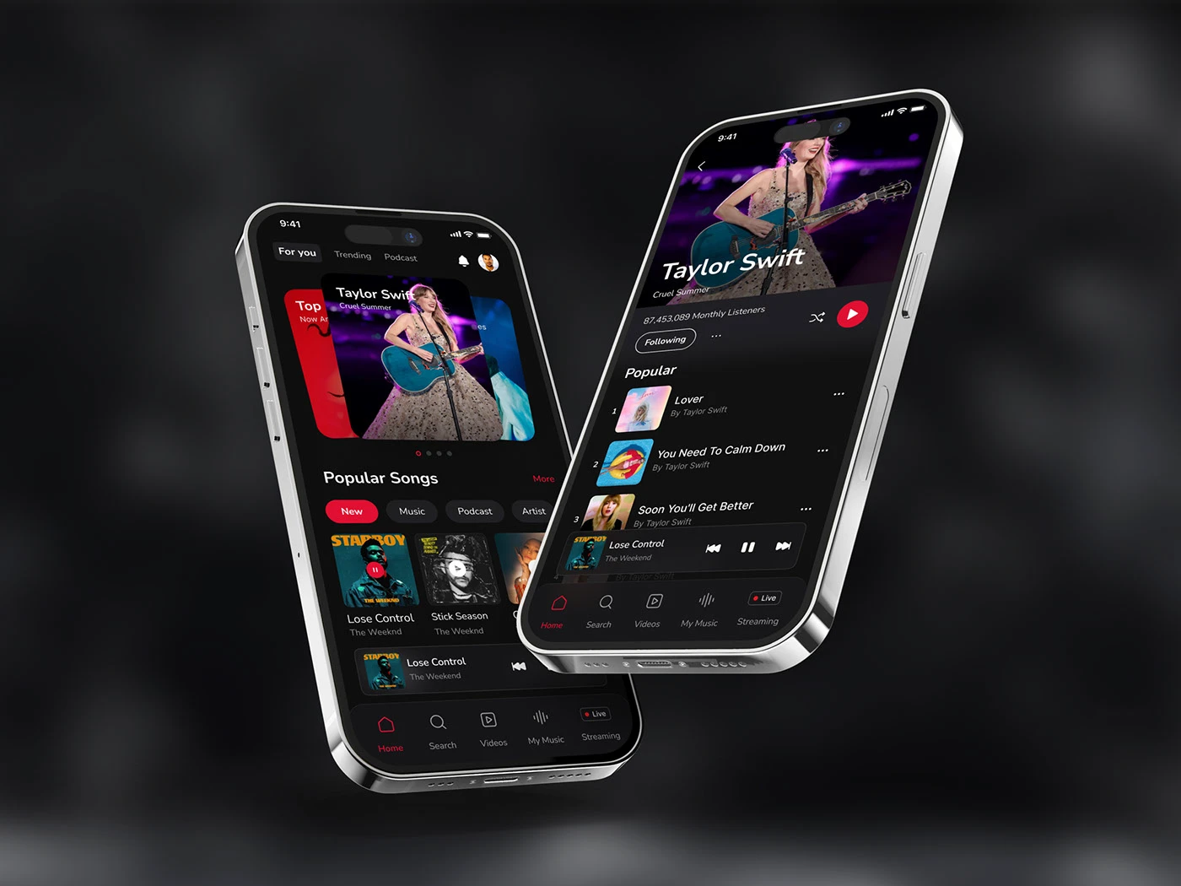
Motivation
Music apps rely on recommendations
Users want songs that match their mood
AI helps personalize music experiences
Notes:
I chose this problem because music recommendation is something we all experience every day. Platforms like Spotify and Apple Music rely heavily on AI to keep users engaged. Instead of manually searching for songs, users expect the system to understand their taste and mood automatically. I wanted to explore how a simple machine learning model could recreate that idea.

Slide 3
Introduction
🎧
🤖
👍
Input
Model
Output
Predict if a user will like a song
Song features (energy, danceability, etc.)
Like (1) or Not Like (0)
Notes:
The main goal of this project is to predict whether a user would like a song based on its audio features. The input to the model includes features like energy, danceability, and tempo. The output is a binary decision: liked or not liked. This makes the problem a classification task.

Slide 4



How Music Recommendations Work
• Music Platforms uses machine learning
• Recommendation methods:
- Content-based filtering
- Collaborative filtering
• Challenge:
- Modeling user taste
Notes:
Music platforms use machine learning to recommend songs based on both user behavior and song characteristics. Two common approaches are content-based filtering, which focuses on song features, and collaborative filtering, which uses behavior from similar users. One major challenge is that music taste is very personal and complex, which makes it difficult to model accurately.

Slide 5
Methods
Dataset
Features
Models
Target
Music info.csv
~50,000 songs
energy
danceability
valence
tempo
Logistic Regression
Decision Tree
Random Forest ⭐
KNN
1 = Liked
0 = Not Liked
Notes:
For this project, I used a dataset with about 50,000 songs and their audio features. Since the dataset did not include actual user preferences, I created a ‘liked’ label based on high-energy and high-danceability songs to simulate user taste. I tested four models: Logistic Regression, Decision Tree, Random Forest, and KNN. These were chosen to compare different types of machine learning approaches.

Slide 6

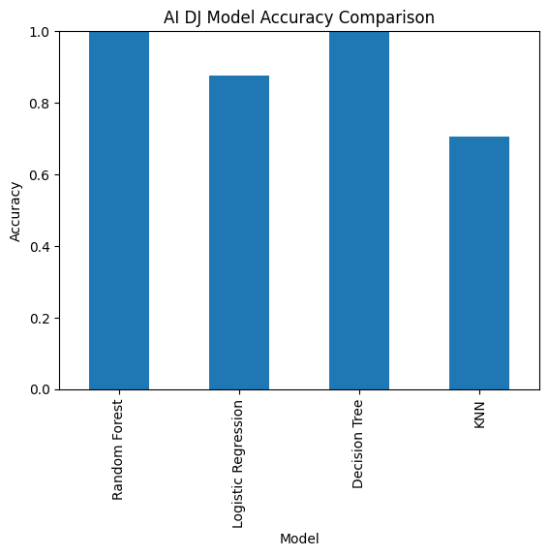
Results
Random Forest and Decision Tree performed best
Notes:
Here are the results of the models. Both Random Forest and Decision Tree achieved very similar performance. I selected Random Forest as the final model because it is more robust and less likely to overfit compared to a single decision tree. This makes it more reliable for real-world applications.

Slide 7
AI DJ Output
 | Name | Artist | Year | Energy | Danceability | Valence | Tempo
2 | Come as You Are | Nirvana | 1991 | 0.826 | 0.508 | 0.543 | 120.012
5 | Somebody Told Me | The Killers | 2005 | 0.979 | 0.508 | 0.704 | 138.030
6 | Viva la Vida | Coldplay | 2013 | 0.806 | 0.588 | 0.520 | 137.973
12 | Feel Good Inc. | Gorillaz | 2010 | 0.720 | 0.809 | 0.832 | 138.556
15 | Lithium | Nirvana | 1991 | 0.656 | 0.678 | 0.485 | 123.207
16 | Song 2 | Blur | 2012 | 0.723 | 0.676 | 0.779 | 129.700
21 | Supermassive Black Hole | Muse | 2010 | 0.891 | 0.667 | 0.837 | 120.010
31 | Dani California | Red Hot Chili Peppers | 2006 | 0.913 | 0.556 | 0.730 | 96.184
34 | Clint Eastwood | Gorillaz | 2012 | 0.712 | 0.659 | 0.556 | 167.948
39 | Losing My Religion | R.E.M. | 2014 | 0.736 | 0.668 | 0.629 | 126.978
41 | Time Is Running Out | Muse | 2003 | 0.854 | 0.575 | 0.443 | 118.225
42 | I Kissed a Girl | Katy Perry | 2008 | 0.760 | 0.699 | 0.696 | 129.996
47 | Heart-Shaped Box | Nirvana | 2007 | 0.842 | 0.609 | 0.459 | 115.158
59 | Float On | Modest Mouse | 2004 | 0.893 | 0.646 | 0.559 | 100.951
61 | Can't Stop | Red Hot Chili Peppers | 2002 | 0.938 | 0.618 | 0.875 | 91.455
62 | She Will Be Loved | Maroon 5 | 2011 | 0.704 | 0.697 | 0.520 | 102.024
65 | Naïve | The Kooks | 2012 | 0.791 | 0.559 | 0.716 | 103.380
77 | This Love | Maroon 5 | 2007 | 0.862 | 0.714 | 0.764 | 95.038
83 | Sultans of Swing | Dire Straits | 2013 | 0.815 | 0.736 | 0.921 | 148.152
86 | Kryptonite | 3 Doors Down | 2012 | 0.805 | 0.546 | 0.529 | 99.010
Notes:
This is where the AI DJ comes to life. First, the model predicts which songs the user would like based on their features. Then, I filter those songs and sort them by vibe, using energy, danceability, and valence. The result is a playlist of recommended songs that match the user’s preferred vibe. This simulates how a real music platform would generate personalized recommendations.

Slide 8
Discussion
What worked?
Random Forest performed best
Features captured song vibe
Challenges
No real user data
Simulated “liked” labels
Notes:
One thing that worked well is that Random Forest was able to capture complex relationships between the song features. However, a key limitation is that I had to simulate user preferences instead of using real user data. Because of that, the recommendations may not fully reflect real-world behavior.

Slide 9
Future Directions
📊 Real user data
🤖 Deep learning models
🎧 Playlist-based recommendations
👥 Better personalization
Notes:
If I continued this project, I would use real user listening data to improve accuracy. I would also explore more advanced models like deep learning and build a system that generates full playlists instead of individual song predictions. This would make the AI DJ more realistic and personalized.

Slide 10
Conclusion
ML can recommend music Random Forest worked best AI DJ concept works
Notes:
In conclusion, this project showed that machine learning can be used to recommend songs based on audio features. Random Forest performed the best, and the AI DJ concept successfully generated a playlist based on vibe. This demonstrates how even simple models can simulate real-world recommendation systems.

